Slide 1


,
HR Resume Processing System using MAKE
ZZ Enterprises is revolutionizing its HR operations with a tailored automation solution that enhances efficiency, organization, and candidate experience.
By MAKE DEVELOPERS
Chirag joshi (20ETCCS023)
Gaurav Vashishtha (20ETCCS042)
Pratham Singh Tanwar (20ETCCS090)
Mohammed Anjar (20ETCCS073)

Slide 2

Automated Resume Sorting
Inbox Scanning
Organized Storage
Incoming HR emails are automatically scanned for job application details.
Resumes are saved by date in the "Resumes" folder for easy access.
1
2
3
Resume Identification
Resumes are detected and separated into a dedicated "Resumes" folder.

Slide 3
Candidate Information Database
Comprehensive Tracking
Chronological Entries
Data Accuracy
Candidate information, including name, email, contact, and LinkedIn, is extracted and recorded in a centralized database.
Candidate entries are logged in the database with a unique serial number and the date of receipt.
Automated data extraction ensures precision and reduces the risk of manual errors.

Slide 4
Personalized Candidate Outreach
1
Confirmation Email
2
Friendly Tone
3
Transparent Next Steps
Candidates receive a personalized email acknowledging the receipt of their application.
The email is crafted with a warm and professional tone, addressing the candidate by their first name.
The email informs candidates that ZZ Enterprises will be in touch soon regarding the next steps.

Slide 5


Efficient Resume Storage
Automated Archiving
Structured Organization
Resumes are automatically saved to a shared network drive, organized by the date of receipt.
The "Resumes" folder ensures a clear and consistent filing system for all incoming applications.

Slide 6




Workflow Optimization
Streamlined Process
The automated HR workflow eliminates manual tasks, saving time and resources.
Increased Productivity
HR professionals can focus on more strategic initiatives rather than repetitive administrative work.
Improved Candidate Experience
The efficient handling of applications enhances the overall experience for job seekers.

Slide 7
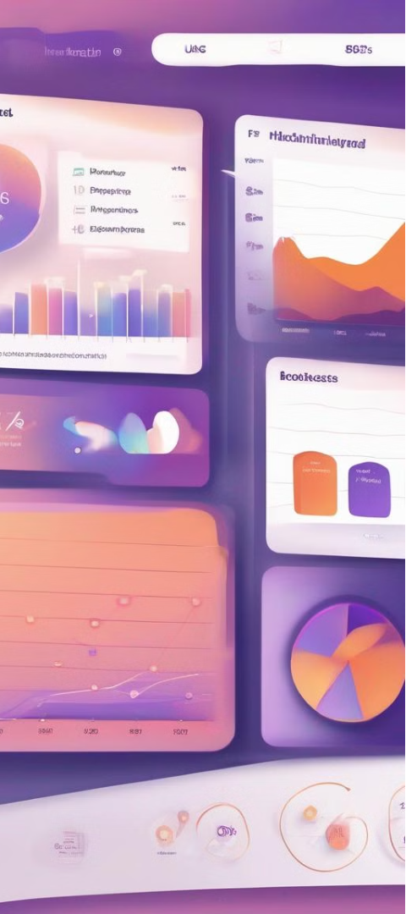
Reporting and Analytics
Recruitment Insights
Data-Driven Decisions
The system generates detailed reports on candidate sources, hiring trends, and process efficiency.
HR managers can leverage these insights to make informed decisions and optimize recruitment strategies.
Continuous Improvement
The analytics enable ZZ Enterprises to identify areas for improvement and enhance the HR function over time.

Slide 8



Scalable and Secure
Scalable Infrastructure
Data Protection
Cloud-Based Flexibility
The automation solution is built on a scalable and secure infrastructure to accommodate future growth.
Robust security measures ensure the confidentiality and integrity of candidate information.
The cloud-based platform offers flexibility and accessibility for HR teams.

Slide 9
Transforming HR at ZZ Enterprises
Efficiency
Streamlined processes, reduced manual effort, and increased productivity
Organization
Structured resume storage, centralized candidate database, and improved data management
Candidate Experience
Prompt acknowledgment, personalized communication, and transparent next steps
Continuous Improvement
Data-driven insights, optimized workflows, and adaptability to evolving needs

